Slide 1
Is there a difference in crime activity between two different quarter seasons for the year 2020?
Also, which parks had the highest number of crimes for each quarter?

Slide 2
Goal of project
I waw curious to see the differences in crime throughout different times in the years.
Parks are a place where many go with children and family to relax, so I was interested in seeing which parks should I be more cautious of. I believe it is important that we understand that even a public place such as a park is still not immune to crime activity
Summer is known for higher crime rates and I wanted to see if this data reflected that

Slide 3
Data Sources
I gathered my data from the NYC Open Data website
I was sent over to the NYC.Gov website at https://www1.nyc.gov/site/nypd/stats/crime-statistics/park-crime-stats.page
This is the NYPDs data webpage that hosts several data sets from different quarters of previous years
I downloaded two datasets as Excel files and then converted into csv.files
Each data set is about 1150 rows and about 12 columns

Slide 4
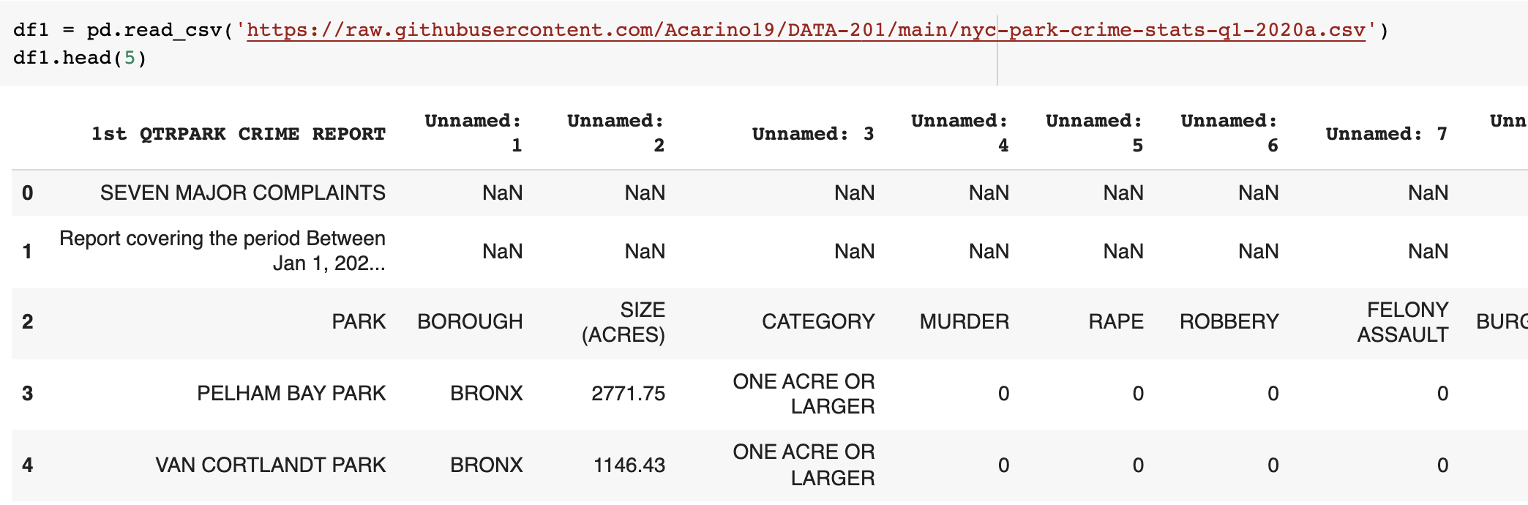
Methodologies
The tools/techniques I used for this project were
- python libraries
- data cleaning
- data visualizations
Libraries: numpy, pandas, matplotlib
Raw dataset:

Slide 5
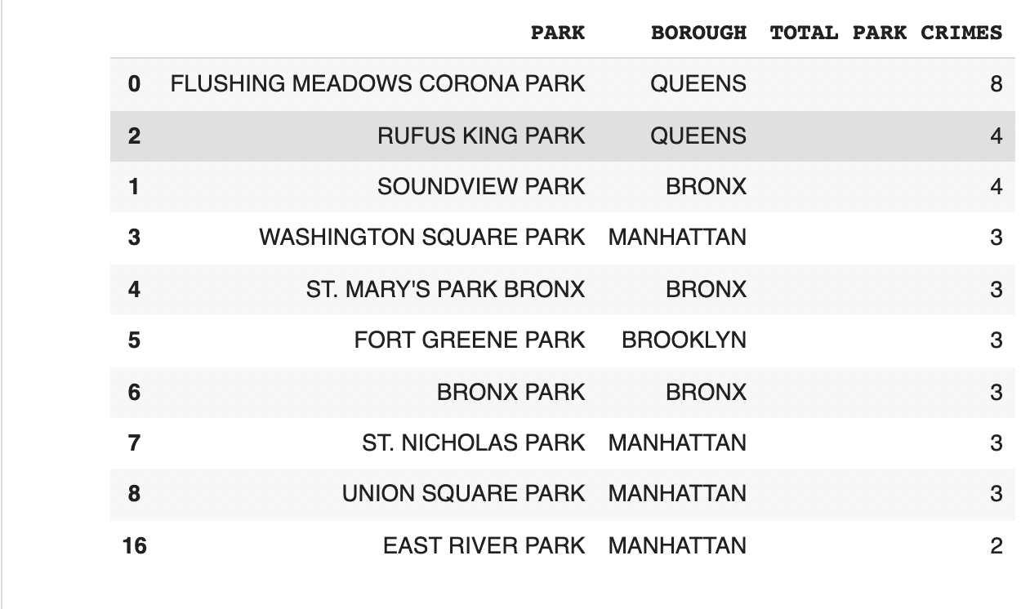
Methodologies
QUARTER 1 2020
For this dataset I manly removed and renamed columns, removed unneeded rows, reset the index and converted object values into numerical values
I also had to remove parks or rows that had 0 crimes committed during that quarter as I only wanted to focus on crime numbers
Final result: Top 10 parks that had high crime activity:

Slide 6
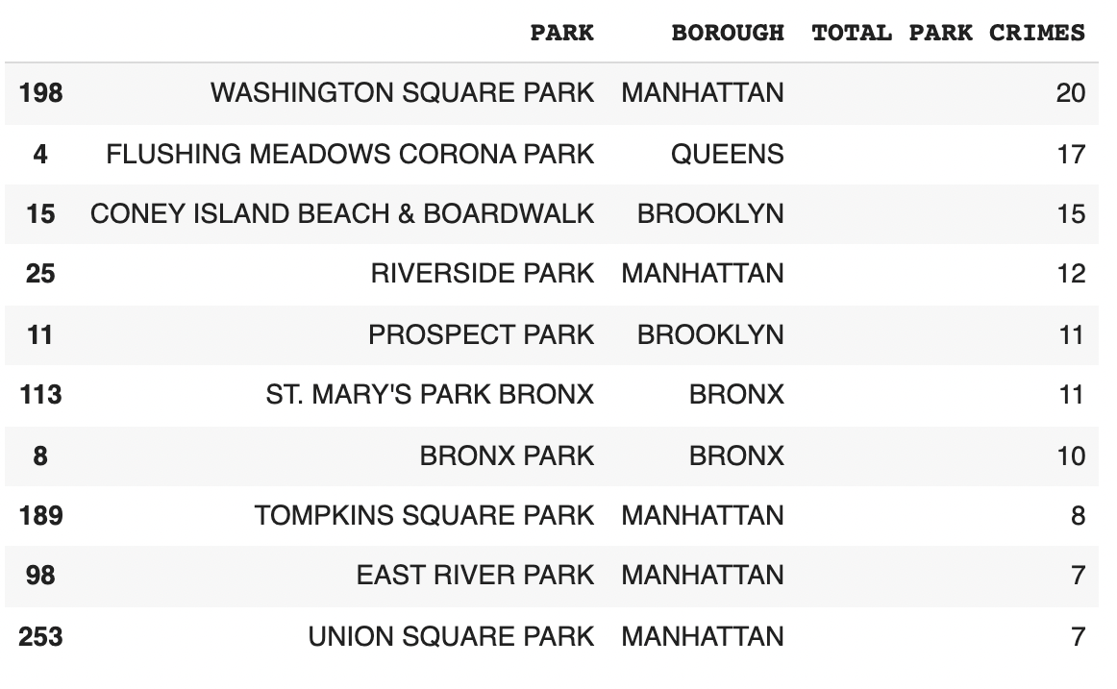
Findings and Conclusions
QUARTER 3 OF 2020
Repeat the same process for Q3 dataset:
Final dataset of top 10 parks with highest crime activity for Q3 of 2020

Slide 7
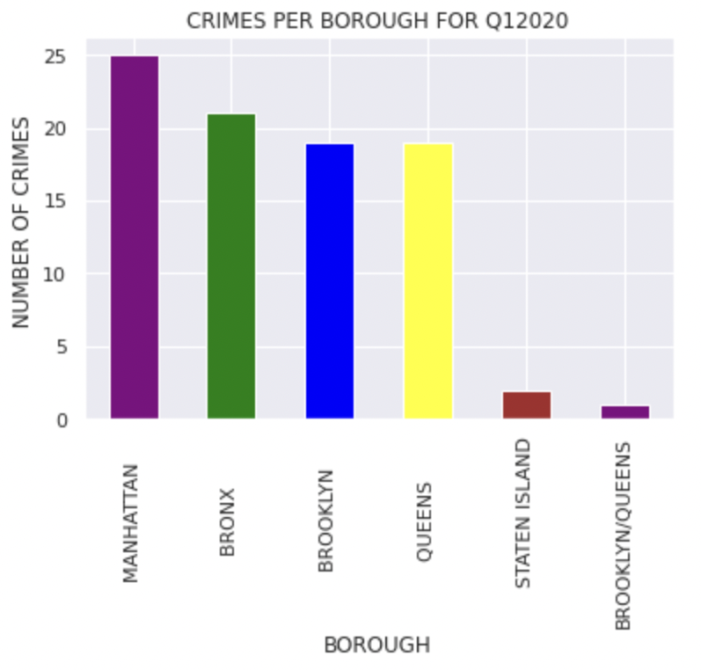
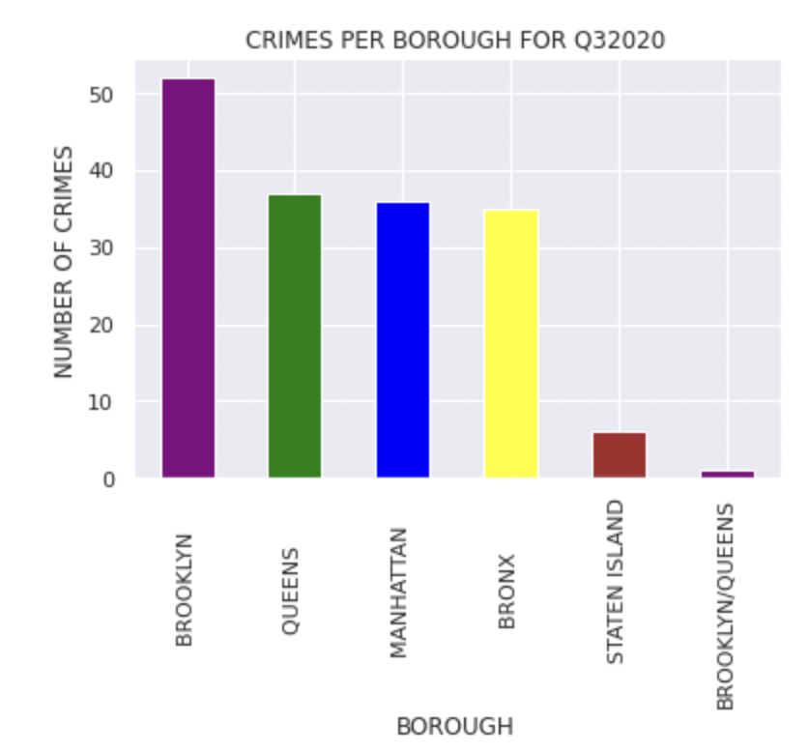
Findings
There were more crimes committed in parks for Q3 of 2020
The borough with the highest number of crimes were different for each quarter

Slide 8
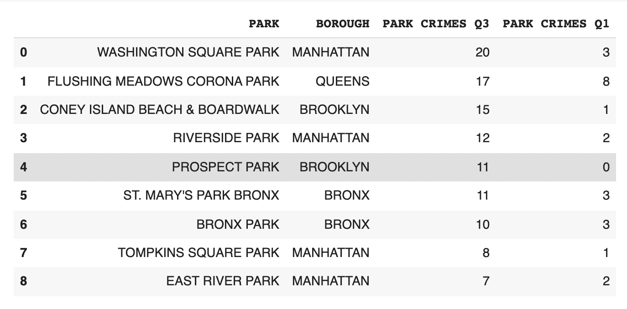
Findings and Conclusions
I combined both datasets into one two see a side by side comparison of the data/numbers
Conclusion:
- More crime was commited in the summer /warmer months of 2020
Flushing Meadows Corona Park ranked 2nd

Slide 9
References
Google.com
https://www1.nyc.gov/site/nypd/stats/crime-statistics/park-crime-stats.page

